Slide 1
EIB - using Europe’s leverage and how to account for it
Jonathan Taylor, Vice-President
Brussels, 14 October

Slide 2
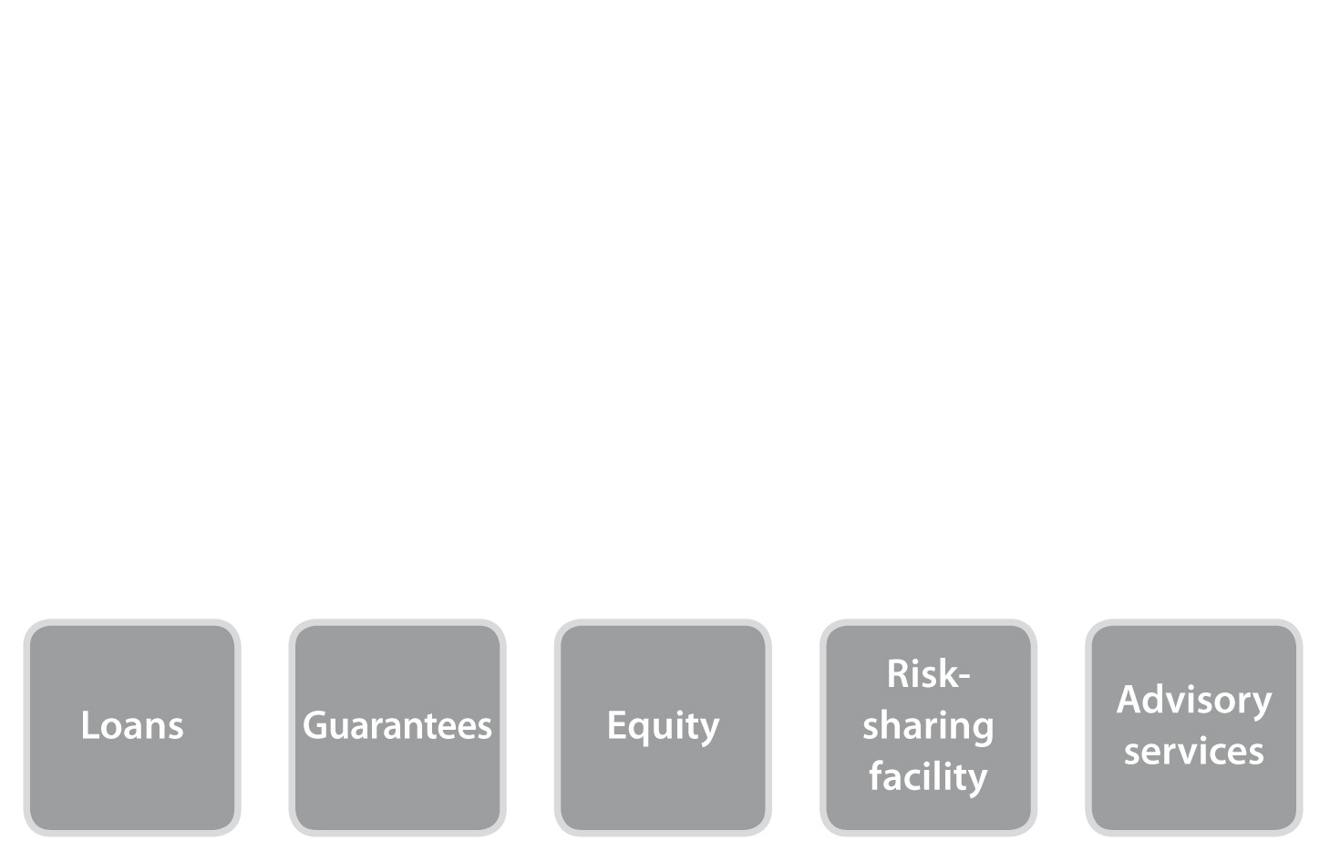
The EIB at a glance
Providing finance and expertise for sound and sustainable investment projects. Total assets of EUR 512 billion at end 2013.
Natural financing partner for the EU institutions
Shareholders: 28 EU Member States
Largest multilateral lender and borrower in the world
Raise our funds on the international capital markets
Pass on favourable borrowing conditions to clients
AAA-rated and strong capital base
Projects in over 160 countries
Key products:

Slide 3
The Governance of the EIB
The Governors of the Bank appoint the Members of the Board of Directors, the Management Committee and the Audit Committee
Board of Governors
Independent Audit Committee
28 members (28 EU Finance Minister)
6 members and up to 3 observers
Board of Directors
Sole responsibility for decisions on loans, guarantees and borrowings. Ensures that the Bank is managed in line with the Treaty, the Statute and the Governors’ directives
29 directors (28 MS + 1 EC)
18 alternates
+6 experts
Management Committee
The Bank’s permanent executive, the day-to-day running of the EIB, preparing decisions for Directors and their implementation
President
8 Vice-Presidents

Slide 4
The Audit Committee
6 members appointed by the Board of Governors, who are responsible for the auditing of the Bank’s accounts to:
Verify that the activities of the Bank conform to best banking practice
Confirm that the financial statements give a true and fair view of the financial position of the Bank in respect of the Bank’s assets, liabilities, results of operations and cash flow
As obliged by law: Financial statements are audited by an independent external auditor, appointed by and reporting directly to EIB`s independent Audit Committee
Audited financial statements, once approved, no later than four months after the year end, are published on the Bank’s website www.eib.org
Notes:
“How” – Audit Committee has an important independent supervisory roll to support the EIB in achieving results at a high standard of practice

Slide 5
Other control functions
IG/Internal Audit
IG/Operations Evaluations
Four independant internal control functions within EIB`s Inspectorate General (IG)
Office of the Chief Compliance Officer
IG/Fraud Investigations
IG/Complaints Mechanism
Notes:
“How” – Audit Committee has an important independent supervisory roll to support the EIB in achieving results at a high standard of practice

Slide 6
The EIB institutional web
Development/ International Financial Institutions
Council
Cooperation:
Co-financing
Peer review
European
Parliament
European Data Protection Supervisor
Mandates
Annual report
OLAF
EIB
If fraud
Opinion on every EIB project
If EU budget
European Court of Auditors
Guarantees outside the EU
If complaint not addressed
Court of Justice of the EU
European Commission
“blending” EU budgetary resources
RSFF model
“Project bonds”…
European Ombudsman
Notes:
“Institutional -Initiatives” – “Reinforce lobbying capacity”

Slide 7
We are unique: A Bank and a public institution
Our governing bodies are made up exclusively of representatives appointed directly by EU Member States
Our financial statements are published within four months of the year end
We have an independent Audit Committee
Operating in the markets on competitive terms
Embedded in the family of EU institutions
Board of Governors: 28 EU Finance Ministers
Board of Directors: High Finance Ministry officials + Experts
Management Committee: Experts in a variety of fields
Audit Committee: Auditors, Bankers, Supervisors
Compliance with international rules and best banking practice
Audited by big 4 for compliance for public issuers
The Audit Committee reports directly to Governors on the financial position and on compliance with best banking practices

